Slide 1
CS 448
PSO Week -6
Indexing in SimpleDB

Slide 2
SimpleDB indexing
Index- Sequentially ordered file
B+Tree Index
Hash Index
Notes:
SimpleDB folder has three different index implementations inside it. We will go over some codes and examples for Sequentially ordered index and B+Tree index

Slide 3
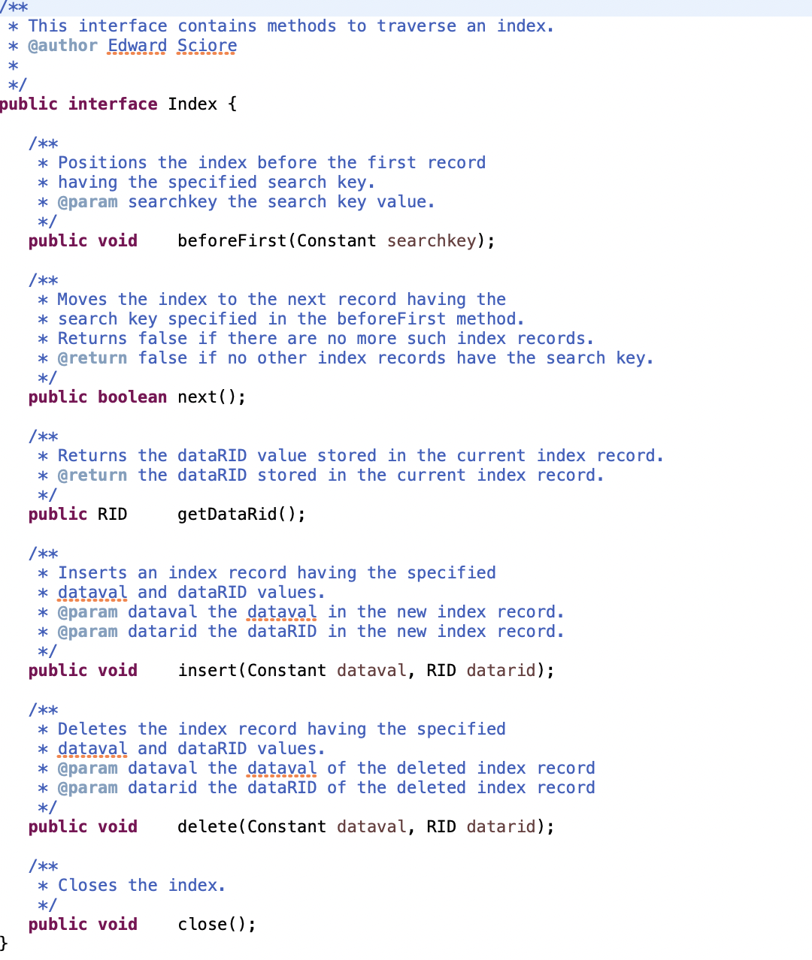
Index Interface
Each record is of the form (dataval,datarid) where dataval is the search key and datarid is the pointer
A RID consists of the block number in the file, and the location of the record in that block.
Notes:
SimpleDB Uses the same interface for all three types of indexing

Slide 4
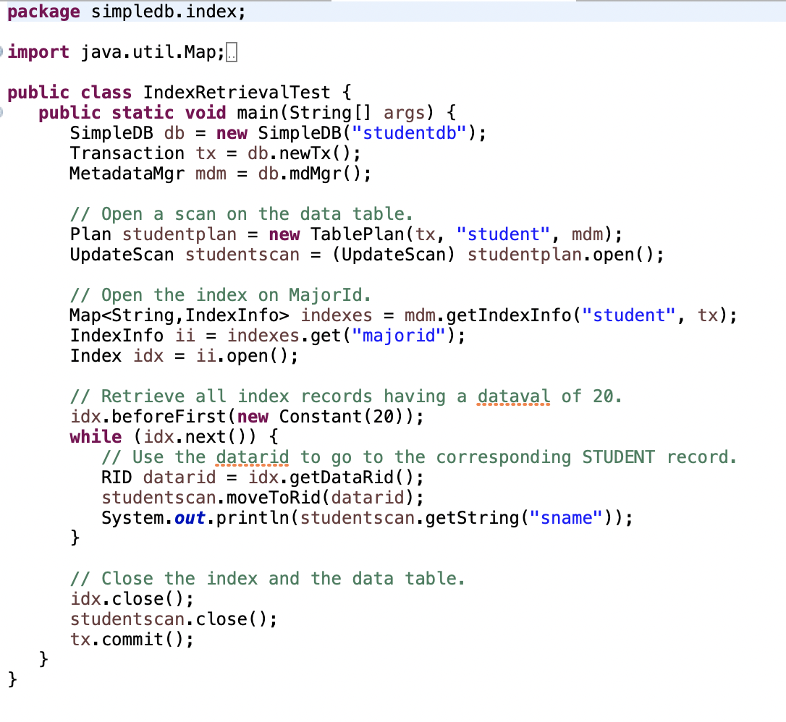
Example 1: Index Retrieval
Open the Index for “student” table with “MajorId” being the search key for index records
Move to the index record having MajorId or dataval=20, get the RID and go to the corresponding Student record.
Notes:
Both of the examples uses sequentially ordered Dense Index files

Slide 5
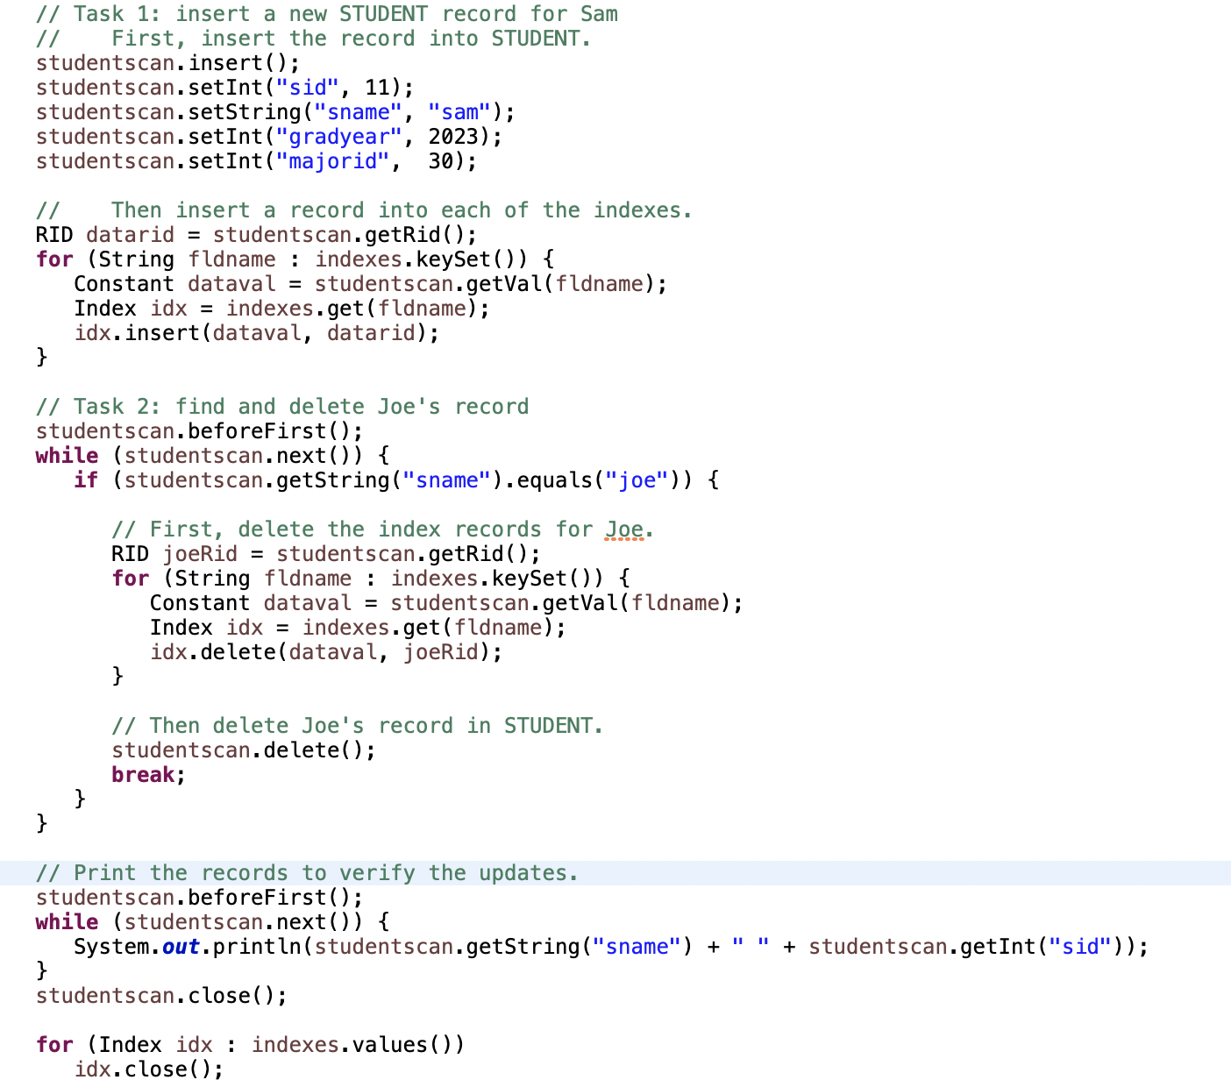
Example 2: Index Update
Insert into the “Student” Record
Insert the record into each of the Indexes
Delete record from Indexes
Delete from the “Student” record
Notes:
The index is a dense index file

Slide 6
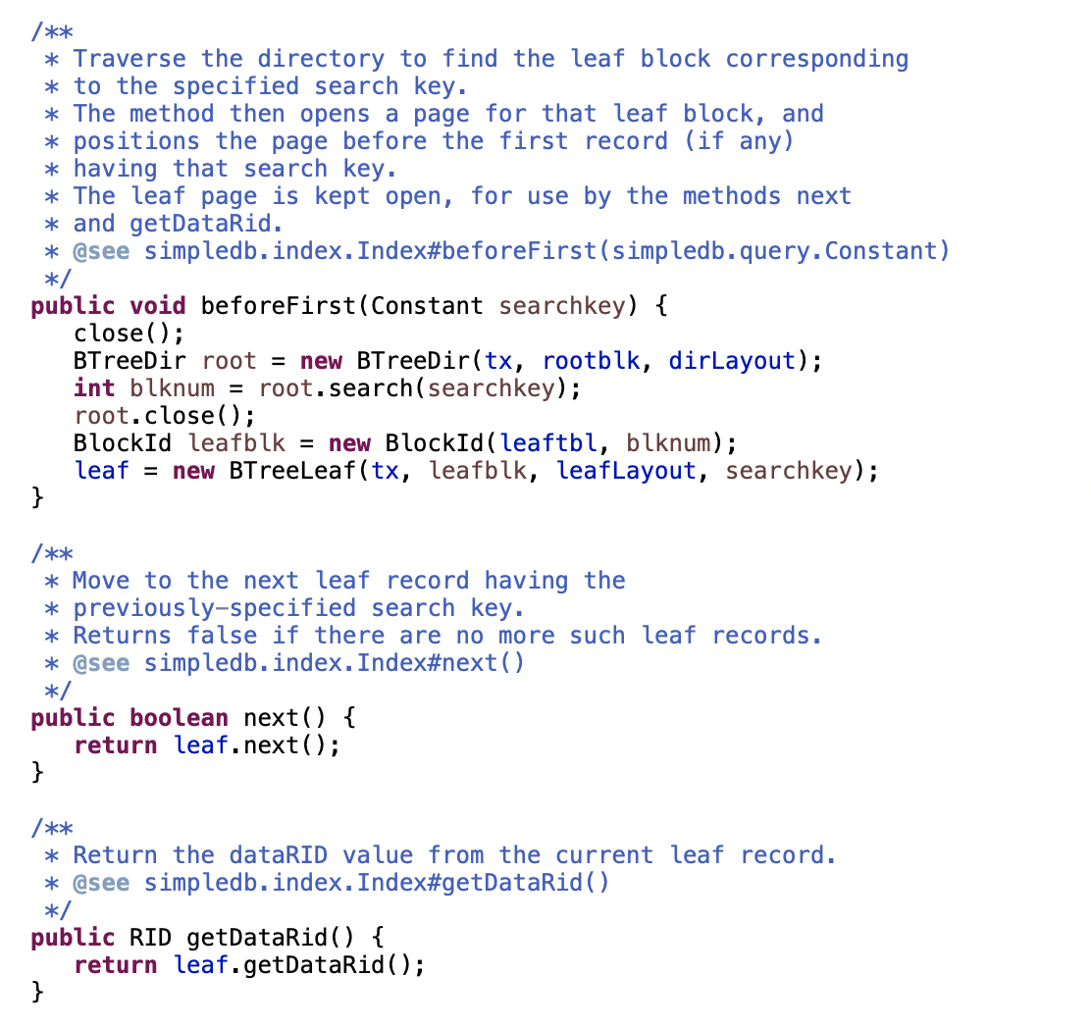
B+ Tree
Index
Notes:
Tree level search for leaf node
Notice how scanning for index records has changed compared to the last sequential examples.
Search: Traverse the B+ Tree to find the “Leaf Block” based on the search key. Once found, a page is being opened for that leaf block and is kept open for finding RID purpose and until close() function is called.

Slide 7
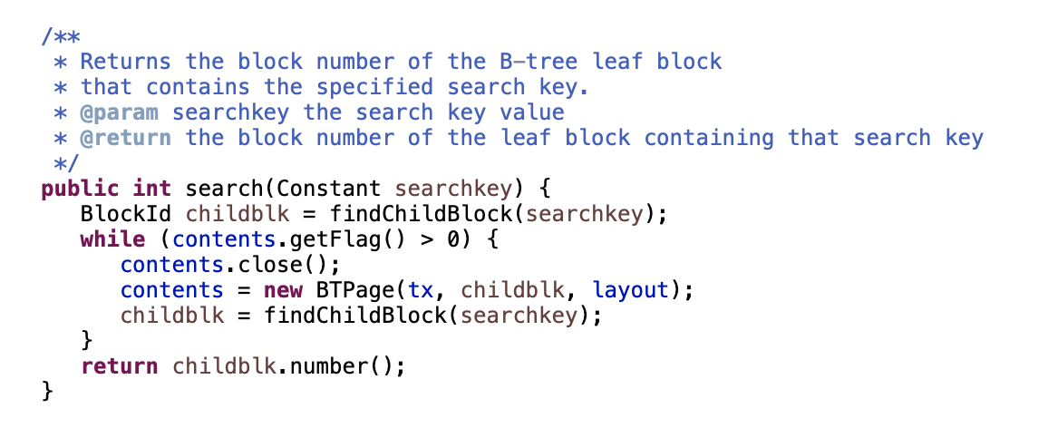
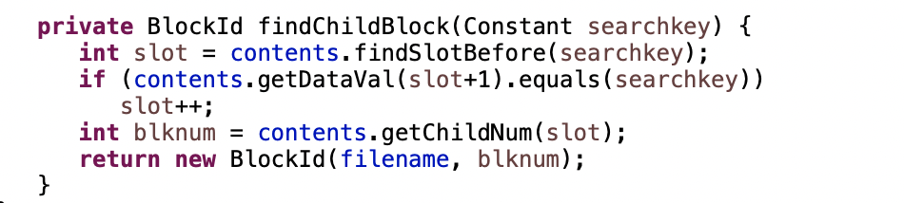
Search Mechanism
Notes:
Tree search cont.
The beforefirst() function in the tree search uses the search() and findChildBlock() functions here to search a tree for a leaf node w.r.t a specified search key.
Notice how the search helper functions does not use recursion and keep passing a lot of flags back and forth in order to find the block for the leaf node.

Slide 8
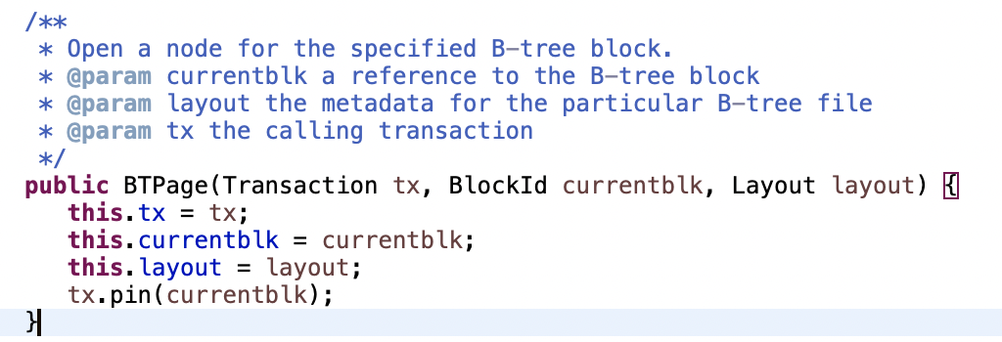
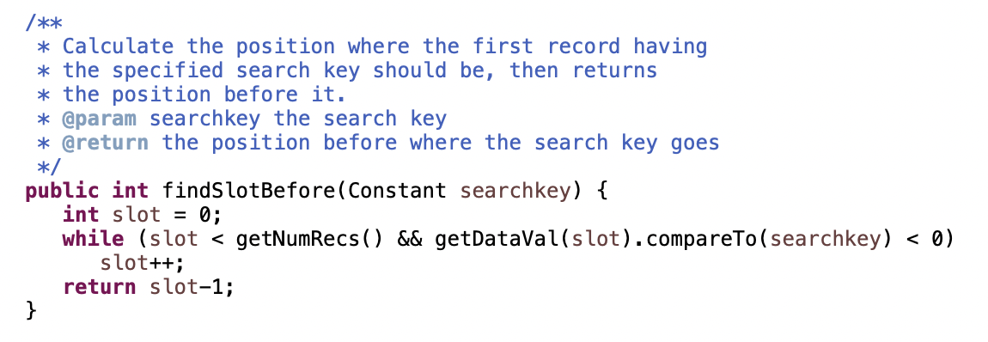
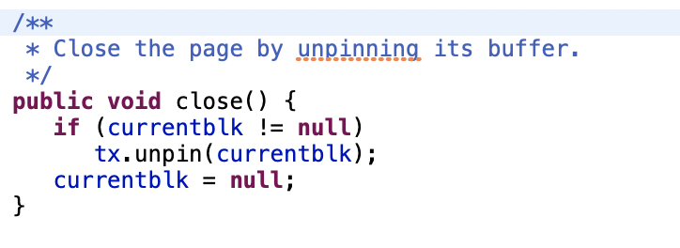
B+ Tree
Page
Notes:
Page level search or search inside a leaf node. Once a page for a leaf node is opened, a leaf level or search inside a BTPage means you are now scanning the node itself.
In simpleDB, B+ Tree indexing implements a paging mechanism of it’s own . The pages have information on current transaction, BlockID for a specific node in the B-tree, metadata, etc.
Notice How pages are being pinned and unpinned while accessing a B+-Tree node or closing it.
Discussion: (Key Point)
Why do you think too much work has been done to implement a simple B+ Tree search? Discuss.
Because they wanted to avoid recursion and that is why they needed a lot of functions with flags being passed back and forth. With Recursion, B+ Tree is quite simple to implement
And that way less error occurs, unlike this one!

Slide 9
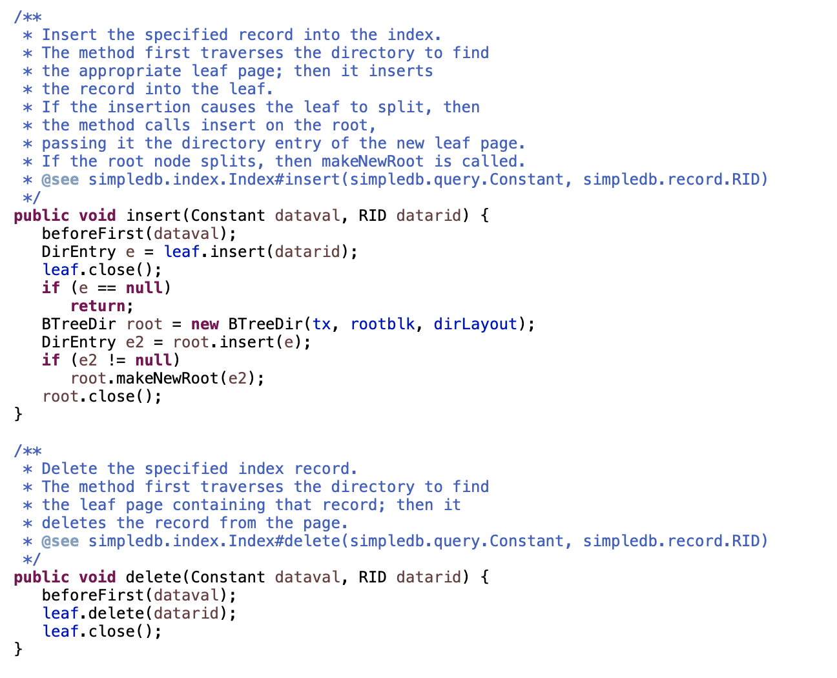
B+ Tree
Index cont.
Notes:
Notice presence of slitting a node while insertion

Slide 10
Thank You

